Slide 1
Network-Accelerator Co-Design for Dynamic Inference of Natural Language Processing
宋玉红
2020.08.09

Slide 2
Experiment
Pre-trained model Vs. pruning model
weighted accuracy 84.67%
Original model(5 epochs): model training 5 epochs from scratch
Submodel1: pruning model using mask1 at original, pruning number=3
Submodel2: pruning model using mask2 at original, pruning number=5
Submodel3: pruning model using mask3 at original, pruning number=7

Slide 3
Experiment
Fine-tune just for one mask
Original model(5+5 epochs): continue training 5 epochs from a 5 epochs training model
→Submodel1: just using mask1 to prune model and update weight
→Submodel2: just using mask2 to prune model and update weight
→Submodel3: just using mask3 to prune model and update weight

Slide 4
Experiment
Simple fine-tune model Vs. pruning fine-tune model
weighted accuracy 90.44%
→Submodel1: just using mask1 to prune model and update weight
Submodel2: using mask2 at shared weight model
Submodel3: using mask3 at shared weight model

Slide 5
Experiment
Simple fine-tune model Vs. pruning fine-tune model
weighted accuracy 90.00%
weighted accuracy 91.33%

Slide 6
Experiment
Use weighted loss to update model
Subloss weight: 0.3, 0.2, 0.5
weighted accuracy 92.00%
Subloss weight: 0.33, 0.33, 0.33
weighted accuracy 92.00%

Slide 7
Experiment
Using block size = 4
Before weighted loss training
weighted accuracy 76.67%

Slide 8
Experiment
Evaluate after training
Subloss weight: 0.2, 0.5, 0.3
weighted accuracy 91.33%
Subloss weight: 0.33, 0.33, 0.33
weighted accuracy 91.33%

Slide 9
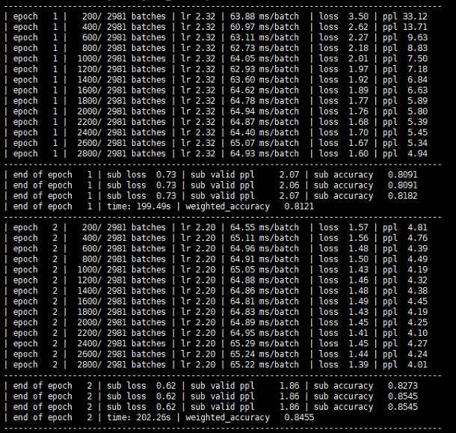
Experiment
Intermediate result

Slide 10
Experiment
Add different mask on best shared model

Slide 11
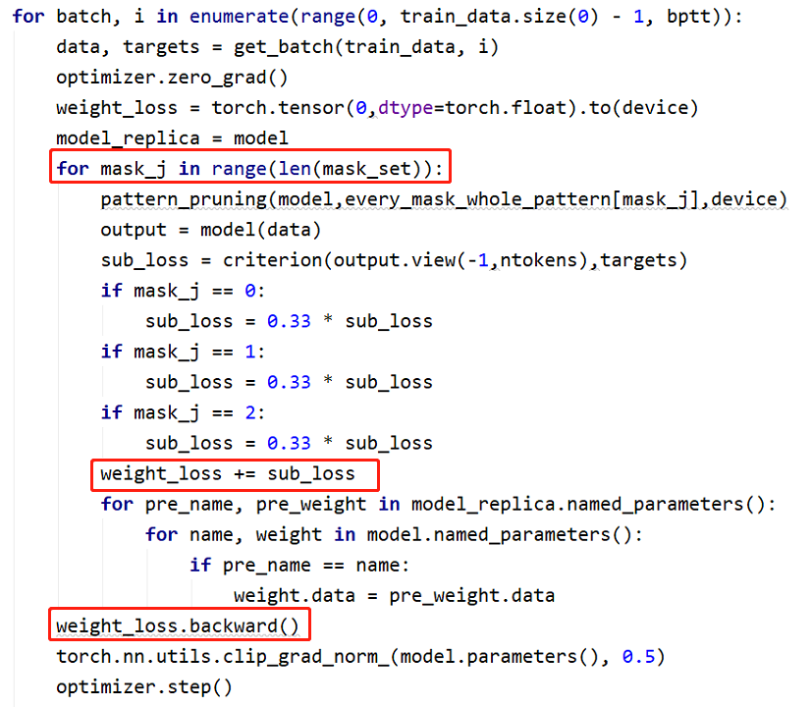
Experiment
Code

Slide 12
Experiment
Code

Slide 13
Experiment
Code

Slide 14
Experiment
Code

